Slide 1
The Science of Language
Joy Mills
7 MAY 2025

Slide 2
Schedule
7 May: Intro to the Science of Language
9 May: Language Development
13 May: Comparing Human And Animal Language
14 May: Is Language Arbitrary?
20 May: Language and Thought
22 May: Prosody: the Music of Language
23 May: Language Roundtable

Slide 3

Objectives
Introduce the many levels of Language Science
Introduce the many elements of language
Explain why speech perception is a hard problem, and ways that the brain/mind solves it.

Slide 4
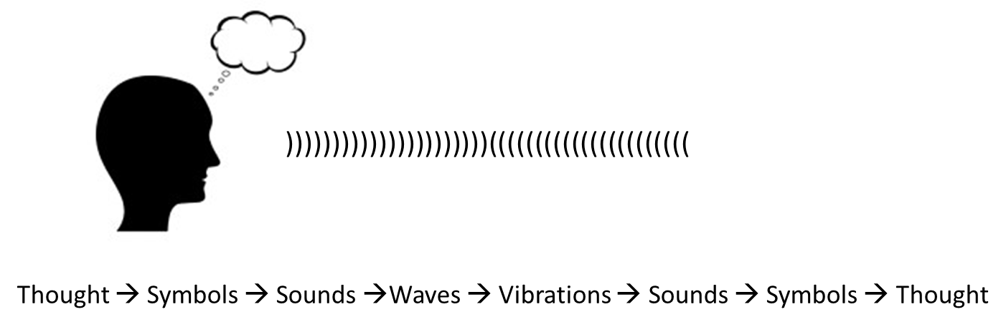


Slide 5
What is Linguistics?
There are many branches of linguistics​
Formal ​
Applied​
Socio-​
Psycho-​
Corpus​
Computational​
And more …​

Slide 6
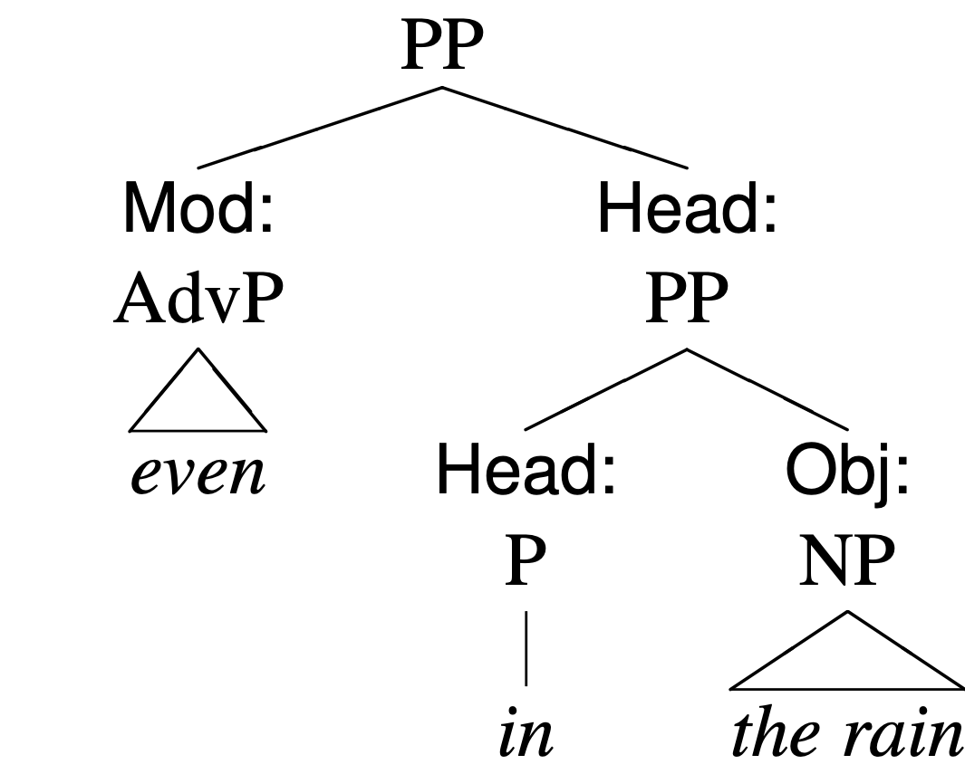
Formal Linguistics
Often syntax-focused
Formally describing languages of
the world
Looking for Universals

Slide 7

Sociolinguistics
Language variation and change
Discourse Analysis
Conversation Analysis
Translanguaging

Slide 8

Corpus/Computational Linguistics
Looks at a corpus (a collection of language)
Can be across modalities (written, spoken, sign)

Slide 9

Psycholinguistics
How the brain processes language
Explores the underpinnings of
all other aspects of Linguistics

Slide 10

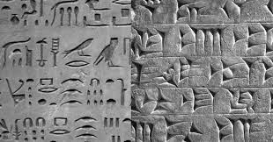

Modalities of Human Language

Slide 11
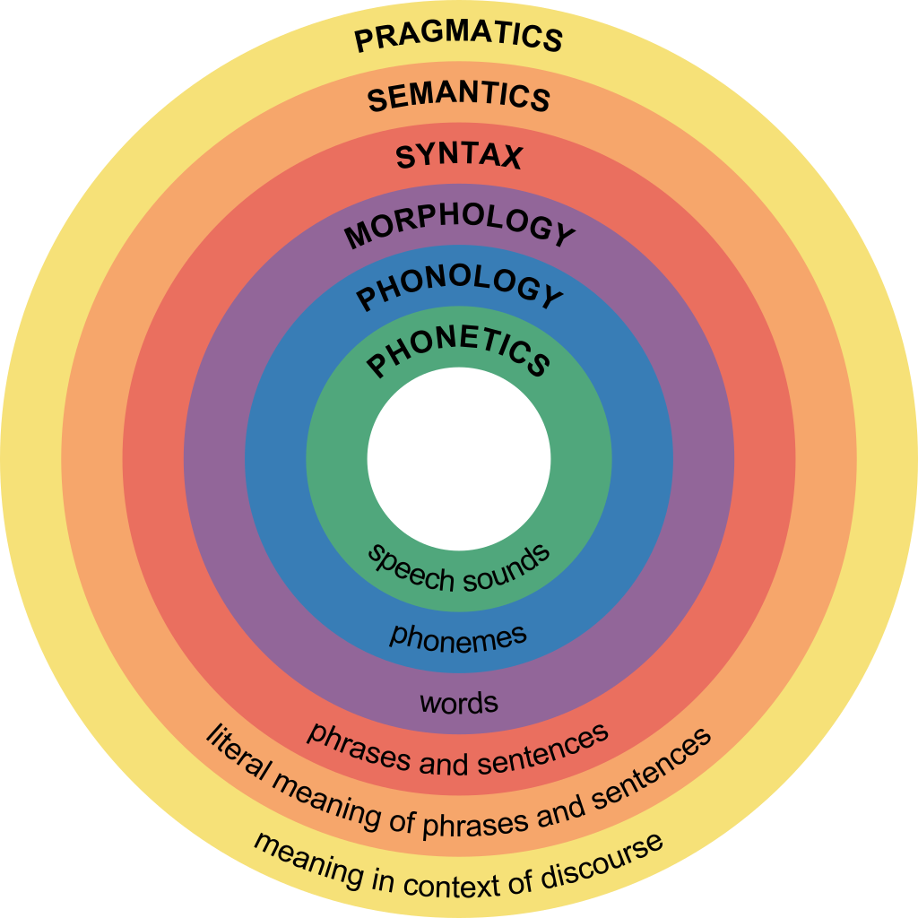
Hierarchy of Language

Slide 12
Pragmatics
How language is used for communication between people
Discourse
Conversation
Semantics
The meaning of words, sentences, and narratives.
Syntax
The rules that dictate how words are combined into sentences, questions, past and future tense etc. Also called “grammar”
Morphology
speech sounds that have meaning
Root morphemes – jump, cup, pillow, quick
Bound morphemes – -ing, -ed, un-, dis-, -ly (prefixes and suffixes that change the meaning of a root)
Morphemes combine to make words
Phonetics/Phonology – the speech sounds that are used in a language
English has 46 phonemes
Te reo has 15 phonemes + 5 diphthongs

Slide 13
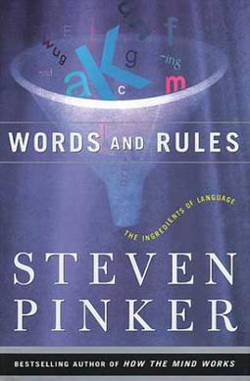
Words and Rules
Rules dictate how phonemes combine, how morphemes combine, how words combine.
Prescriptive Grammar: The “official” accepted grammar of a language.
Descriptive Grammar: A description of the rules that people use in natural language.
Many rules are implicit.

Slide 14
The umbrella open is.*
I went to the store on Easter Sunday, but it was closed for the holiday.
You are studying for the test.
Why test you the study for?*
The empty big yellow car is waiting for you.
The red hungry small fox is in the garden.*
I gave my friend a book.
I donated my friend a book.*

Slide 15
Linguistic Universals (Hockett, 1960)
1. Semanticity
Language is made up of symbolic units that combine to express meaning.
2. Arbitrariness
Sounds, letters, pictographs, signs bear no relationship to meaning.
Different languages use different symbols
3. Displacement
We can use language to talk about here and now, but also past/future and real/imagined.
4. Productivity/Generativity
A fixed number of units can be combined in an infinite number of ways.

Slide 16
Productivity
Finite number of sounds used in a given language.
171,000 words (but we make up new ones all the time).
Infinite # sentences.
Sentences combine to produce an infinite number of narratives.

Slide 17
antidisestablishmentarianism
anti dis establish ment arian ism
antidisestablishmentarianisms
antidisestablishmentarianismic
antidisestablishmentarianismically

Slide 18
Recently added
Adulting
Cold open
Flirtationship
Google (verb)
Simp
Spidey sense
Wingsuit
Gatekeep
Cabbage (adj)
Shockeroo
Toploading
Bruncheon
Exemplificatory
Gochujang
Kaitiakitanga
Hackability
Paddleboard
Pickleball
https://www.oed.com/information/updates/september-2023/

Slide 19
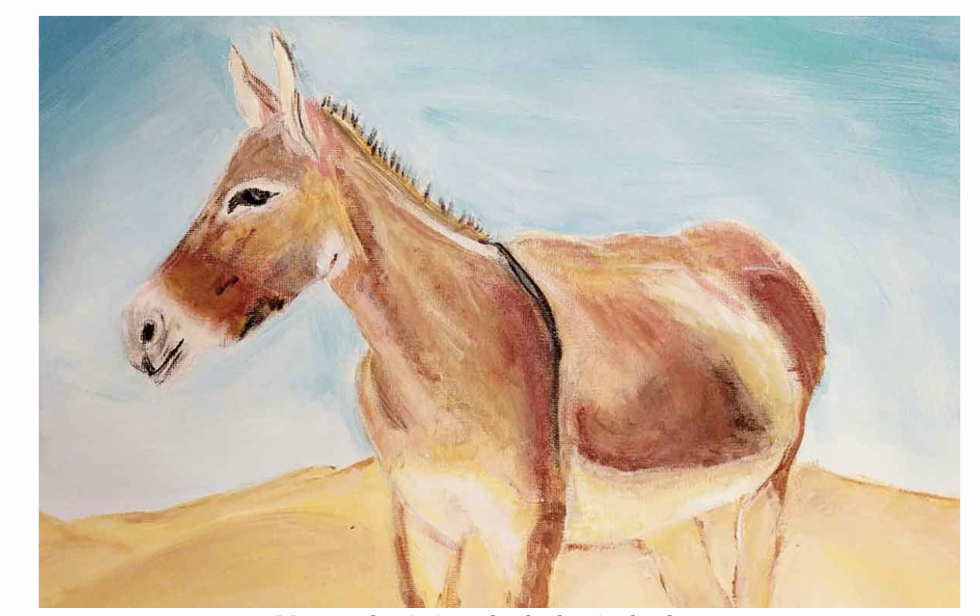
https://schollz.github.io/sentences/

Slide 20
Most sentences are unique
A 25 billion
A painting 22 million
A painting of 5 million
A painting of a donkey 131,000
A painting of a donkey in the 1
A painting of a donkey in the desert. 0
https://schollz.github.io/sentences/

Slide 21
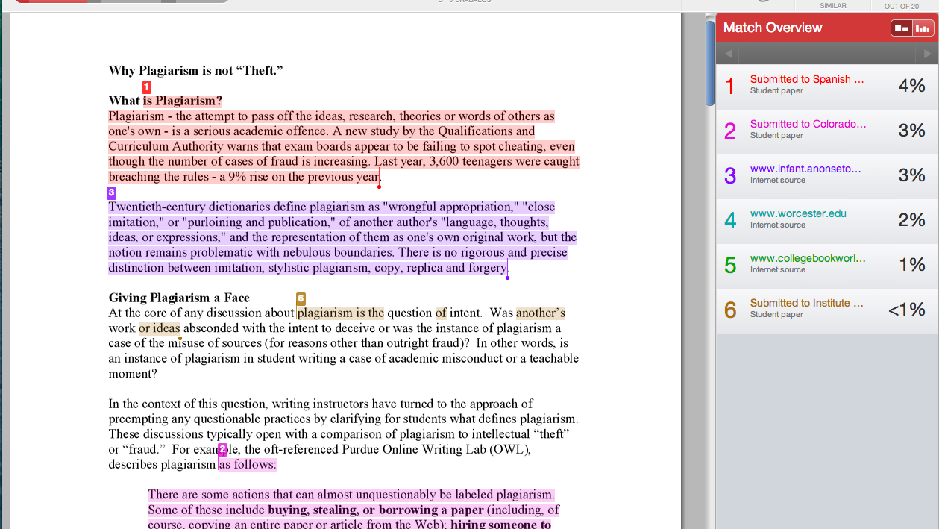

Slide 22
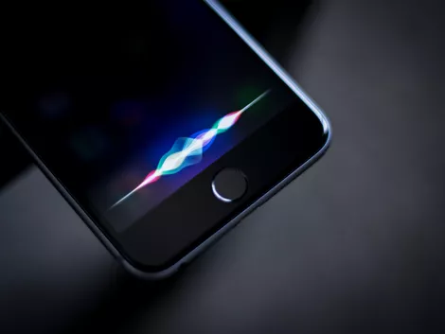
The Sounds of Language
OR, WHY IS SPEECH PERCEPTION SO DAMN HARD?

Slide 23
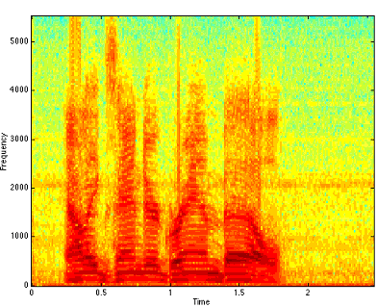
What is speech?

Slide 24
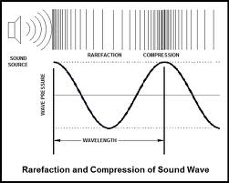
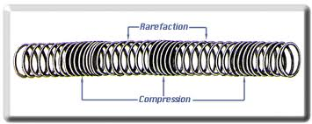
A Sound Wave

Slide 25
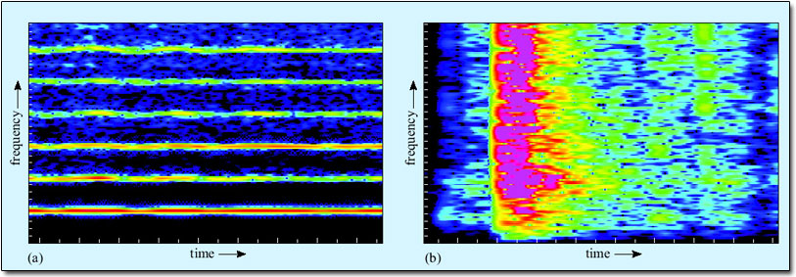
The Spectrogram
formants
Fundamental frequency
flute
Box dropping on floor

Slide 26
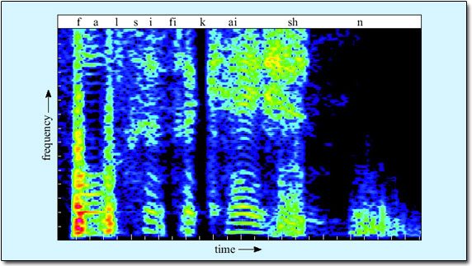

Slide 27
Why is speech production/perception so hard?
Segmentation
Co-articulation
Individual differences

Slide 28
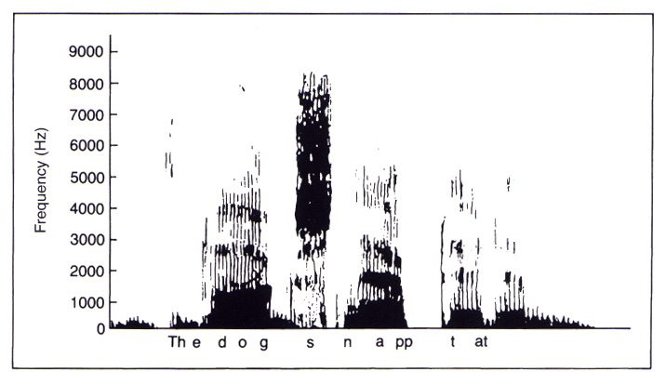
1. Segmentation
The pauses don’t appear between words, they appear in the middle of words.

Slide 29
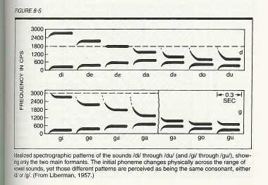
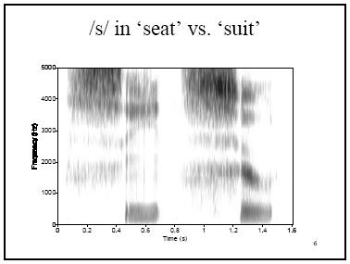
2. Phonemes are altered by surrounding phonemes
coarticulation

Slide 30
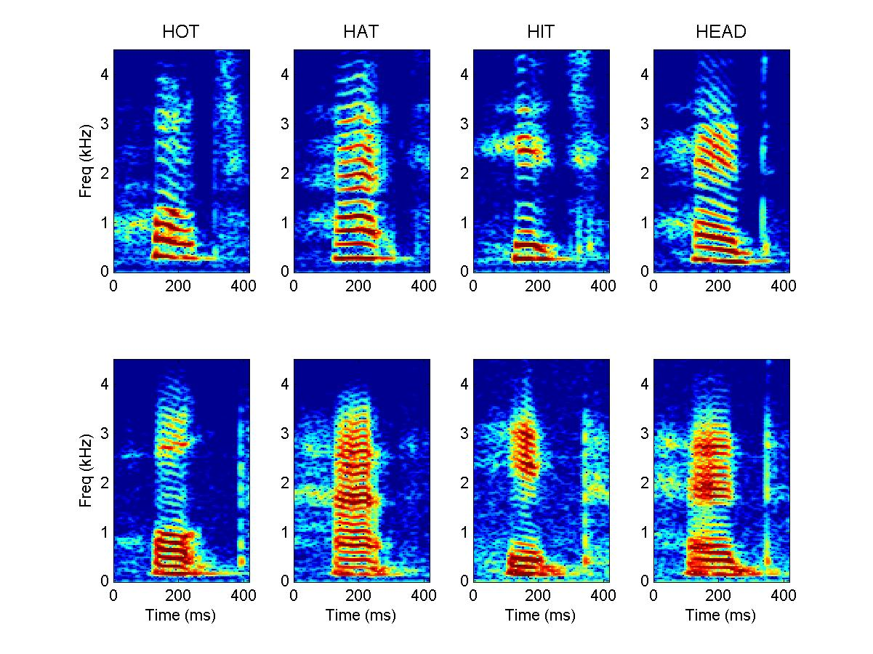
3. Individual voices vary
Gender
Age
Emotion
Accent
female
male

Slide 31
Solutions
Context (top-down processing)
Visual cues (multisensory integration)
Categorical Perception
Language Experience

Slide 32
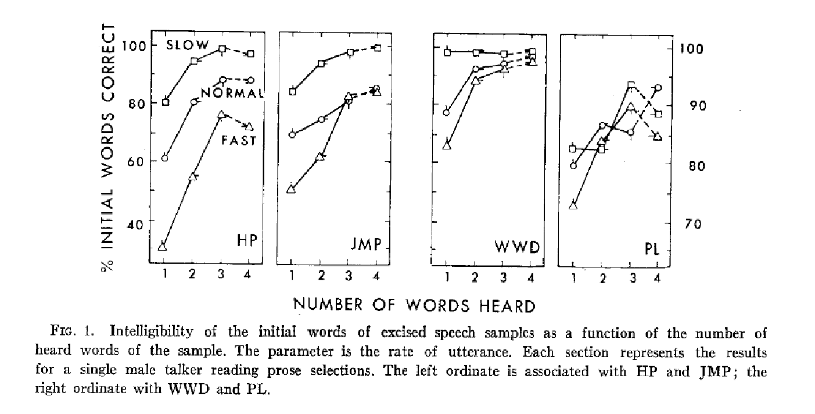
The Importance of Context
Speech sample
Test 1
Test 2
Test 3
Test 4
…of the world was covered in ice.
…of
…of the
…of the world
…of the world was
Pollack & Pickett (1964)
Notes:
gating experiments: Paul’s website

Slide 33
Phonemic Restoration
https://learninglink.oup.com/access/content/sedivy-2e-student-resources/sedivy2e-chapter-7-web-activity-4
The *eel was on the shoe
The *eel was on the axle
The *eel was on the table
The *eel was on the orange
Wheeler (1977)

Slide 34
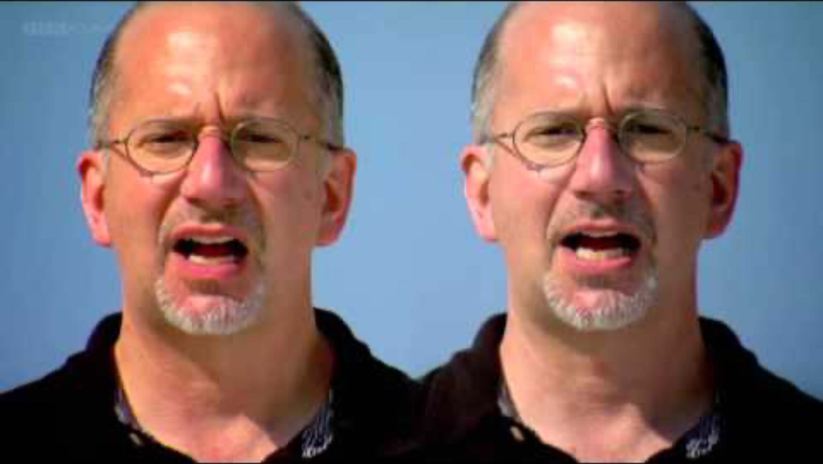
The McGurk effect
Speech perception is multi-sensory
Notes:
https://youtu.be/2k8fHR9jKVM?si=J_7gZx74_OJFGmoq

Slide 35
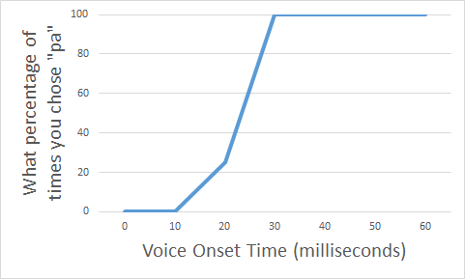
Categorical Perception
Voiced Consonants: ba/da/ga
Unvoiced Consonants: pa/ta/ka

Slide 36
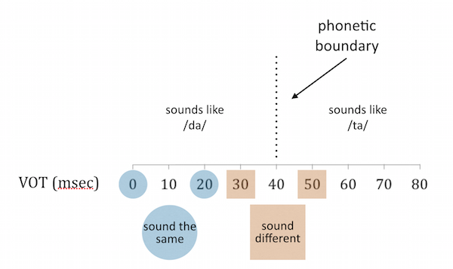
Categorical Perception
Voiced Consonants: ba/da/ga
Unvoiced Consonants: pa/ta/ka

